Slide 1
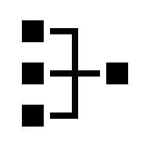
GCP
Cloud Logging
Cloud Monitoring
monitoring
Artifact Registry
Our
VPC
Docker image
GKE
Kubernetes
Google
VPC
Internet
External Application Load Balancer
Docker container:
Go CLI monitoring tool
Docker container:
Django
API server
Cloud SQL PostgreSQL
Cloud NAT Cloud Router
Private Services Access
Pod
Pod

Slide 2
GKE Cluster
Ingress rule
Service
Node
Node
Load
Balancer
CronJob
(1/day)
Docker container:
Django
API server
Docker container:
Go CLI monitoring tool
Docker container:
Django
API server
Pod
Pod
Pod

